Slide 1

Week 9
JINGYA LI

Slide 2
Outline
Unit 3 Quiz Review
Reading Comprehension Text A
Exercises
Group Presentation
Game

Slide 3
Unit 3 Quiz
postulate admonish ingenious mundane confounding
These results remained consistent after adjusting for ______ factors and controlling for other potential sources of bias.
The benefits of this tiny, ______ little innovation were immediate, apparent, and good for my productivity.
Human population is probably a bubble and it might burst, as I ______ in my latest science fiction.
This week we also looked at several ______ inventions that find incredible new uses for everyday items.
In your articles you ______ us to consider reality rather than Utopian notions of community.

Slide 4
Fact or opinion?
Starfish come in many colors and usually have five arms, or rays
In spite of their name, starfish are not really fish at all, since they are invertebrates and do not have backbones.
Internet access and the ability to make good use of it is practically a must for success in the modern world.
Perhaps the greatest change the world has seen in modern times has been the rise of the internet.
F
F
O
O

Slide 5
Fact or opinion?
Rocky formerly led the particle astrophysics group at Fermi lab and is now chair of astronomy and astrophysics at the University of Chicago.
Collectively theorists have been scratching their heads ever since trying to explain this finding.
An even more pointed and roaring tribute to experiment came from the utterly self-assured king of experimental physics, Ernest Rutherford.
F
O
O

Slide 6
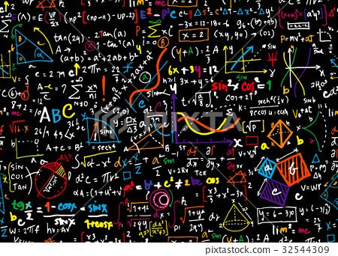

Mathematics

Slide 7
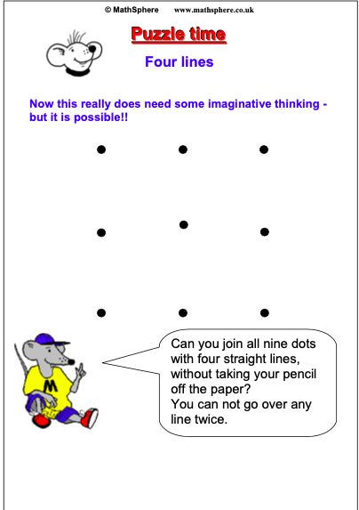
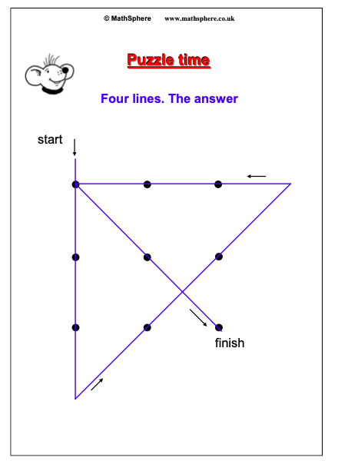
Math Puzzles

Slide 8
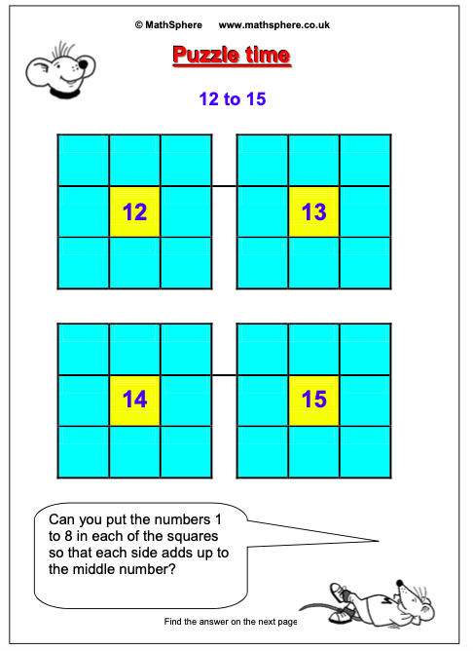
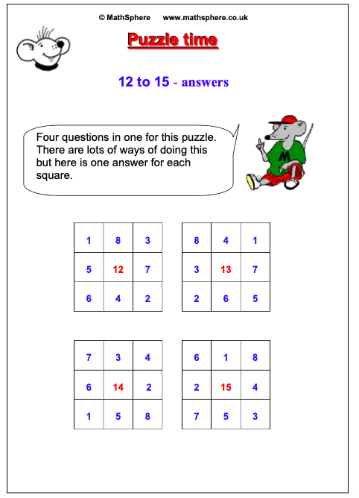

Slide 9

Some history with mathematics
Did you know that Chinese mathematics developed at a time around the 11th century BC? They brought to modern mathematics important concepts related to negative numbers, decimals, algebra and geometry.
The Hindu-Arabic numeric system began developing as early as the 1st century with a full system of numbers being established around the 9th century. This gave birth to the basis of numerical digits for 0-9 that we use in our daily lives now!
"I think, therefore I am," is a well-known saying by Philosopher René Descartes, but this is not the only thing that he should be credited for. He also developed the XY-coordinate system that is used now extensively in medicine and engineering.

Slide 10

Awesome facts about Mathematics
Mathematician Paul Erdos could calculate in his head, given a person's age, how many seconds they had lived, when he was just 4 years old.
The largest prime number ever found is more than 22 million digits long. The largest known prime number 2^{74,207,281} − 1 is a Mersenne prime.
Zero is the only number that can't be represented in Roman numerals.

Slide 11
Lead-in discussion
How do you think mathematicians are contributing to human progress?
Astronomy
The discovery of Neptune
The Goldbach Conjecture
one of the oldest unsolved problems in number theory and in all of mathematics
Every even integer, greater than 2, can be expressed as the sum of two primes
Do you think mathematics is beautiful? Why or why not?

Slide 12
Beauty of Maths
The Beauty of Mathematics is that it can be used to form some amazing pictures that are made up only of numbers that read the exact same both directions.
Sequential Inputs of numbers with 8 1 x 8 + 1 = 9 12 x 8 + 2 = 98 123 x 8 + 3 = 987 1234 x 8 + 4 = 9876 12345 x 8 + 5 = 98765 123456 x 8 + 6 = 987654 1234567 x 8 + 7 = 9876543 12345678 x 8 + 8 = 98765432 123456789 x 8 + 9 = 987654321

Slide 13
Beauty of Maths
Step1: Come up with any 2 single digit numerals.
Step2: Choose from any one of the numbers and multiply it by 2.
Step3: Add 5 to the solution.
Step4: Afterwards, multiply it by 5.
Step5: Add your other single-digit number to the result.
Step6: Deduce 4 from the solution.
Step7: Minus another 21 from the result.
The Answer will be the two single-digit numbers you have first thought of.

Slide 14

Group Presentation

Slide 15
Reading Comprehension
Text A

Slide 16
Key terms
Prime
A number that can be divided evenly only by 1, or itself.
It must be a whole number greater than 1
String theory
All particles in the universe can be divided into two types: bosons and fermions
It predicts supersymmetry exists between these two particle types.
Supersymmetry
Under supersymmetry, a fermion must exist for every boson and a boson for every fermion.
Experiments have not yet detected these extra particles

Slide 17

Sirens
Beautiful but dangerous creatures that lured the sailors with their beautiful voices to their doom, causing the ships to crash on the reefs near their island.

Slide 18
Theme of Text A
There is beauty in mathematics in addition to its utility.
The beauty and elegance of mathematics is corroborated by famous mathematicians and scientists.
However, the author also cautions that beauty may be a fallible guide in seeking truth.

Slide 19
Organization of Text A
Section 1: Paras. 1-4
There is beauty in mathematics, and mathematicians perceive a beautiful formula with emotional responses.
Section 2: Paras. 5-14
Ample evidence and research have proved the beauty of mathematics.
Section 3: Paras. 15-18
Beauty may lead to truth, but caution must be exercised to guard against fallacy.
Section 4: Paras. 19-20
The concept of beauty is not in conflict with the meaning and power of maths.

Slide 20
Key sentences
1. Maths becomes beautiful through the power and elegance of its arguments and formulae; through the bridges it builds between previously unconnected worlds. (Para. 2)
数学之美，在于其论证和公式的力量和优雅，在于它贯通了原本不相干的世界。

Slide 21
Key sentences
2. For those who learn the language, maths has the same capacity for beauty as art, music, a full blanket of stars on the darkest night. (Para. 2)
对于学习数学这门语言的人而言，数学和艺术、音乐以及漆黑夜空中的满天星斗一样，可以美轮美奂。

Slide 22
Key sentences
3. Brain scans of mathematicians show that gazing at formulae considered beautiful by the beholder elicits activity in the same emotional region as great art and music.
对数学家的大脑扫描显示，当它们凝视其认为美丽的公式时，所激发的大脑情感区域，与欣赏伟大的艺术和音乐时激发的区域相同。

Slide 23
Key sentences
4. The power of an equation to connect what seem like completely unrelated realms of mathematics comes up often. (Para. 8)
一个等式常常具有将看似完全无关的数学领域联系起来的力量。

Slide 24
Key sentences
5. More than 2,000 years ago, the ancient Greek mathematician, Euclid, solved a numerical puzzle so beautifully that it still makes Neale smile every time it comes to mind. (Para. 10)
2000多年前，古希腊数学家欧几里德完美的解决了一个数学难题，尼尔每念及此便会欣然而笑。

Slide 25
Key sentences
6. With a grasp of the formulae, we can understand blood flow in the body, make boats glide through the water and build awesome chocolate enrobers. (Para. 14)
掌握了这些公式，我们便能理解血液如何在我们的体内流动，建造漂在水中的船只，以及发明制作美味的巧克力的浸挂糖衣机。

Slide 26
Key sentences
7. Shocking at first pass, Dirac captured what is now a common sentiment: when a beautiful equation seems at odds with nature, the fault may lie not with the maths, but in applying it to the wrong aspect of nature. (Para. 15)
乍一看让人惊奇，但狄拉克捕捉到了一种普遍的看法：当一人美丽的方程式看似有悖自然规律时，错误可能不在数学本身，而在于将其用错了领域。

Slide 27
Task 1
compelling
underlying
fallible
elicit
multidimensional
gave rise to
diverse
indivisibility

Slide 28
GRE Math Exercises
Question 1
Difficulty: Easy
The price of a pair of sneakers was $80 for the last six months of last year. On January first, the price increased 20%. After the price increase, an employee bought these sneakers with a 10% employee discount. What price did the employee pay?
$70.40
$82.00
$83.33
$86.40
$88.00
Answer: $86.40

Slide 29
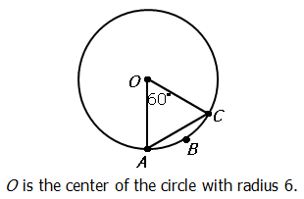
GRE Math Exercises
Column A | Column B
Length of arc ABC | 6
The quantity in Column A is greater
The quantity in Column B is greater
The two quantities are equal
The relationship cannot be determined from the information given
Question 2:
Difficulty: Medium Answer: The quantity in Column A is greater

Slide 30
GRE Math Exercises
Question 3
Difficulty: Hard
A popular website requires users to create a password consisting of digits only. If no digit may be repeated and each password must be at least 9 digits long, how many passwords are possible?
9! + 10!
2 × 10!
9! × 10!
19!
20!
Answer: 2 × 10!
https://gre.magoosh.com/questions/849/a/285134917

